Slide 1

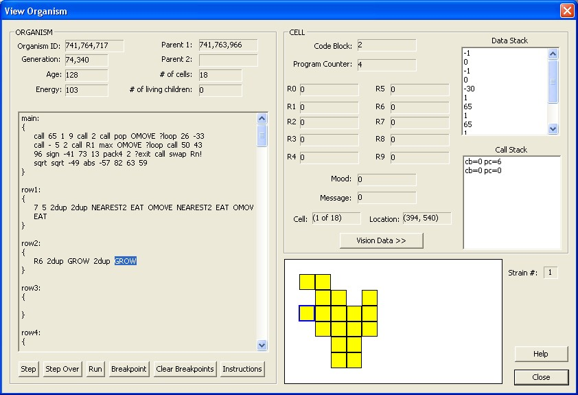

Slide 2
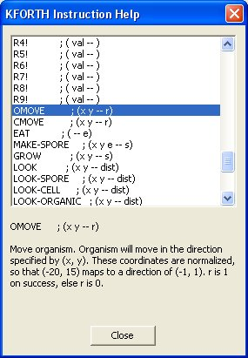

Slide 3

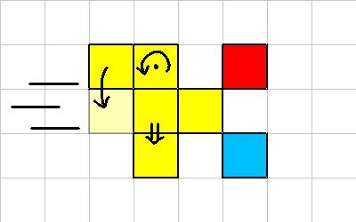

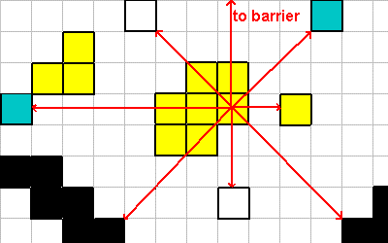

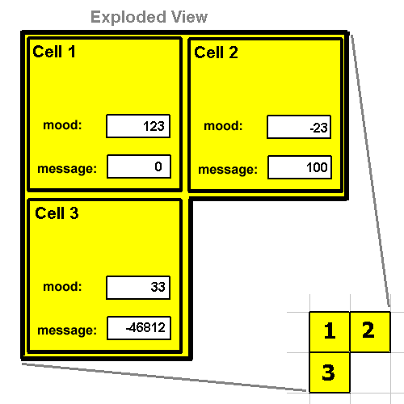

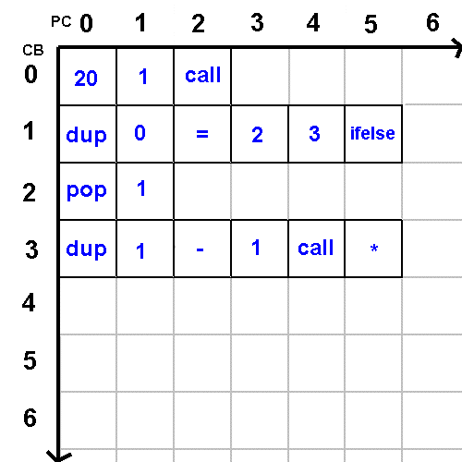
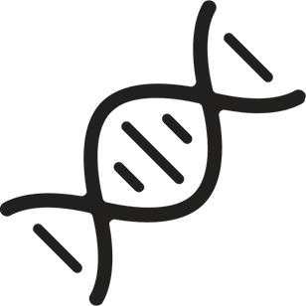
Organism Instructions
ROTATE
Interactions
OMOVE
ROTATE
CMOVE
GROW
MAKE-SPORE
EAT
CMOVE
EAT
OMOVE
MAKE-SPORE
GROW
Vision
LOOK
WHAT
WHERE
NEAREST
FARTHEST
NEAREST2
FARTHEST2
LOOK
Cells
MOOD
MOOD!
BROADCAST
SEND
RECV
Self
ENERGY
AGE
NUM-CELLS
HAS-NEIGHBOR
Genome
main (0)
row (1, 2, ...)

Slide 4








KFORTH Instructions
Flow
call
if
ifelse
?loop
?exit
pop
CB
Stack
dup
swap
over
rot
pick
?dup
-rot
Pair
2swap
2over
2dup
2pop
nip
tuck
( a -- )
( a b )
Maths Single
1+
1-
2+
2-
2/
2*
abs
sqrt
Maths Pair
+
~
*
/
mod
/mod
negate
2negate
Equality
=
<>
<
>
<=
>=
0=
Logic
or
and
not
invert
xor
min
max
SOF008_01
Register Read
Rn
R0
R1
R2
R3
R4
R5
R6
R7
R8
R9
Register Write
Rn!
R0!
R1!
R2!
R3!
R4!
R5!
R6!
R7!
R8!
R9!
Bit Manipulation
sign
pack2
unpack2
pack4
unpack4

Slide 5
https://www.flaticon.com/free-icon/logic-gates_3512387?term=logic&page=1&position=20&origin=search&related_id=3512387
https%3A%2F%2Fwww.flaticon.com%2Ffree-icon%2Fequal_227448%3Fterm%3Dequal&page=1&position=35&origin=search&related_id=227448
https%3A%2F%2Fwww.flaticon.com%2Ffree-icon%2Fversion-control_5251795%3Fterm%3Dcontrol+flow&page=1&position=1&origin=search&related_id=5251795
https://www.flaticon.com/free-icon/cube-of-notes-stack_54637?term=stack&page=1&position=10&origin=search&related_id=54637
https%3A%2F%2Fwww.flaticon.com%2Ffree-icon%2Fgym-rings-couple_30687%3Fterm%3Dpair&page=1&position=11&origin=search&related_id=30687
https%3A%2F%2Fwww.flaticon.com%2Ffree-icon%2Fopen-book_2702134%3Fterm%3Dread&page=1&position=2&origin=search&related_id=2702134
https%3A%2F%2Fwww.flaticon.com%2Ffree-icon%2Fbit_9453169%3Fterm%3Dbit&page=1&position=1&origin=search&related_id=9453169
https%3A%2F%2Fwww.flaticon.com%2Ffree-icon%2Fvision_2989627%3Fterm%3Dvision&page=1&position=13&origin=search&related_id=2989627
https%3A%2F%2Fwww.flaticon.com%2Ffree-icon%2Fcell_2050350%3Fterm%3Dcells&page=1&position=11&origin=search&related_id=2050350
https%3A%2F%2Fwww.flaticon.com%2Ffree-icon%2Fuser_3024605%3Fterm%3Dperson&page=1&position=7&origin=search&related_id=3024605
https%3A%2F%2Fwww.flaticon.com%2Ffree-icon%2Ftest_10192483%3Fterm%3Dgenome&page=1&position=77&origin=search&related_id=10192483
https%3A%2F%2Fwww.flaticon.com%2Ffree-icon%2Finteraction_9121498%3Fterm%3Dinteraction&page=1&position=53&origin=search&related_id=9121498

